Slide 1
Data Analytics using Python
(30 Hours)
Notes:
Title - The learning outcome
Subtitle - Duration

Slide 2
In this section, we will discuss:
Data mining, wrangling, data manipulation techniques
Data cleaning and pre-processing techniques
Data analytics project lifecycle
Numerical Computing using NumPy Library
Notes:
Mention the parent topics one by one. This particular learning outcome has 4 parent topics.

Slide 3
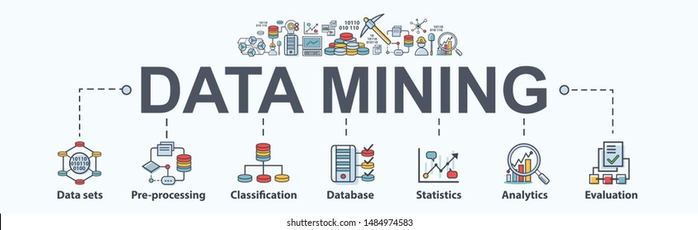
Data mining, wrangling,data manipulation techniques
Data Mining
Data Mining is defined as extracting information from huge sets of data.
Data mining is a process of extracting and discovering patterns in large data sets involving methods at the intersection of machine learning, statistics, and database systems.
Image Source: https://www.shutterstock.com/search/data+mining
Notes:
Left (White Color space):
Title - Parent Topic
Subtitle - Subtopic 1
Body Text - Description in bullets
Right (Grey Color Space):
Body Text - Relevant image (with source)/code snippet
Data mining is the process of sorting through large data sets to identify patterns and relationships that can help solve business problems through data analysis. Data mining techniques and tools enable enterprises to predict future trends and make more-informed business decisions.
Reference:
https://www.shutterstock.com/search/data+mining

Slide 4
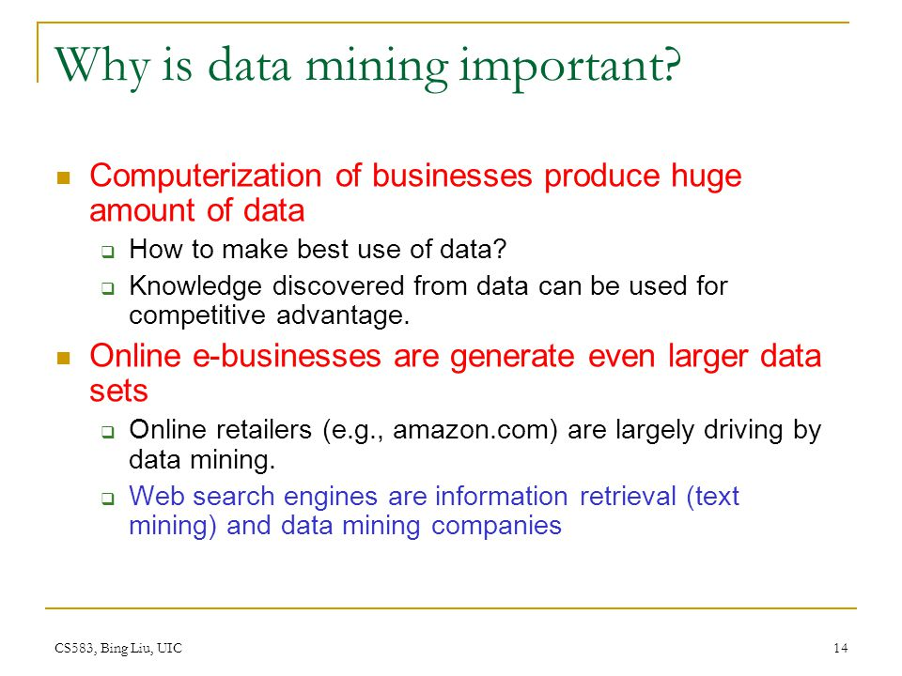
Data mining, wrangling,data manipulation techniques
Why is data mining important?
Data mining tools predict behaviors and future trends, allowing businesses to make proactive, knowledge-driven decisions. Data mining tools can answer business questions that traditionally were too time consuming to resolve.
Image Source: https://slideplayer.com/slide/3900027/13/images/14/Why+is+data+mining+important.jpg
/
Notes:
This slide talks about the case if we have to divide a subtopic further.
Left (White Color space):
Title - Parent Topic
Subtitle - Subtopics of subtopics
Body Text - Description in bullets
Right (Grey Color Space):
Body Text - Relevant image (with source)/code snippet
Data mining is a crucial component of successful analytics initiatives in organizations. The information it generates can be used in business intelligence (BI) and advanced analytics applications that involve analysis of historical data, as well as real-time analytics applications that examine streaming data as it's created or collected.
Reference:
https://slideplayer.com/slide/3900027/13/images/14/Why+is+data+mining+important.jpg

Slide 5
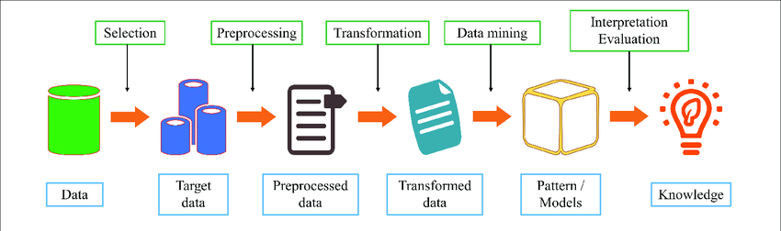
Data mining, wrangling,data manipulation techniques
Data mining Steps
Understand Business
Understand the Data
Prepare the Data
Model the Data
Evaluate the Data
Deploy the Solution
Image Source: https://www.researchgate.net/figure/The-steps-for-data-mining-process_fig3_344166043
Notes:
Left (White Color space):
Title - Parent Topic
Subtitle - Subtopics of subtopics
Body Text - Description in bullets
Right (Grey Color Space):
Body Text - Relevant image (with source)/code snippet
Understand Business
What is the company’s current situation, the project’s objectives, and what defines success?
Understand the Data
Figure out what kind of data is needed to solve the issue, and then collect it from the proper sources.
Prepare the Data
Resolve data quality problems like duplicate, missing, or corrupted data, then prepare the data in a format suitable to resolve the business problem.
Model the Data
Employ algorithms to ascertain data patterns. Data scientists create, test, and evaluate the model.
Evaluate the Data
Decide whether and how effective the results delivered by a particular model will help meet the business goal or remedy the problem. Sometimes there’s an iterative phase for finding the best algorithm, especially if the data scientists don’t get it quite right the first time. There may be some data mining algorithms shopping around.
Deploy the Solution
Give the results of the project to the people in charge of making decisions.
Reference:
https://www.researchgate.net/figure/The-steps-for-data-mining-process_fig3_344166043

Slide 6
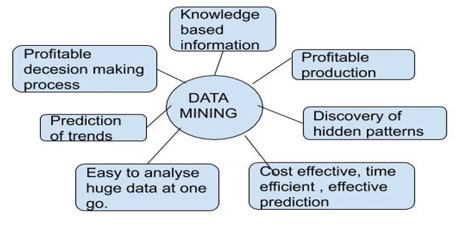
Data mining, wrangling,data manipulation techniques
Benefits of Data Mining
It helps companies gather reliable information.
It's an efficient, cost-effective solution compared to other data applications.
It helps businesses make profitable production and operational adjustments.
Data mining uses both new and legacy systems.
It helps businesses make informed decisions.
Image Source: https://www.includehelp.com/basics/data-mining-introduction-benefits-disadvantages-and-applications.aspx
Notes:
Left (White Color space):
Title - Parent Topic
Subtitle - Subtopics of subtopics
Body Text - Description in bullets
Right (Grey Color Space):
Body Text - Relevant image (with source)/code snippet
The Data Mining technique enables organizations to obtain knowledge-based data.
Data mining enables organizations to make lucrative modifications in operation and production.
Compared with other statistical data applications, data mining is a cost-efficient.
Data Mining helps the decision-making process of an organization.
It Facilitates the automated discovery of hidden patterns as well as the prediction of trends and behaviors.
It can be induced in the new system as well as the existing platforms.
It is a quick process that makes it easy for new users to analyze enormous amounts of data in a short time.
Reference:
https://www.includehelp.com/basics/data-mining-introduction-benefits-disadvantages-and-applications.aspx

Slide 7
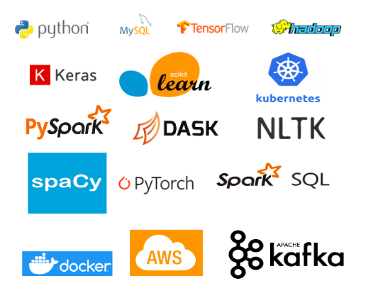
Data mining, wrangling,data manipulation techniques
Data Mining Tools
Artificial Intelligence
Association Rule Learning
Clustering
Classification
Data Analytics
Data Cleansing and Preparation
Data Warehousing
Machine Learning
Regression
Image Source: https://medium.com/@springboard_ind/top-10-data-mining-tools-b06171d476d0
Notes:
Left (White Color space):
Title - Parent Topic
Subtitle - Subtopics of subtopics
Body Text - Description in bullets
Right (Grey Color Space):
Body Text - Relevant image (with source)/code snippet
Artificial Intelligence
AI systems perform analytical functions that mimic human intelligence, such as learning, planning, problem-solving, and reasoning.
Association Rule Learning
This toolset, also called market basket analysis, searches for relationships among dataset variables. For example, association rule learning can determine which products are frequently purchased together (e.g., a smartphone and a protective case).
Clustering
This process partitions datasets into a set of meaningful sub-classes, known as clusters. The process helps users understand the natural structure or grouping within the data.
Classification
This technique assigns particular items in a dataset to different target categories or classes. The goal is to develop accurate predictions within the target class for each case in the data.
Data Analytics
The data analytics process enables professionals to evaluate digital information and turn it into useful business intelligence.
Data Cleansing and Preparation
This technique transforms the data into a form optimal for further analysis and processing. Preparation includes activities such as identifying and removing errors and missing or duplicate data.
Data Warehousing
Data warehousing consists of an extensive collection of business data that businesses use to help them make decisions. Warehousing is a fundamental and necessary component of most large-scale data mining efforts.
Machine Learning
Related to the AI technique mentioned earlier, machine learning is a computer programming technique that employs statistical probabilities to provide computers with the ability to learn without human intervention or being manually programmed.
Regression
The regression technique predicts a range of numeric values in categories such as sales, stock prices, or even temperature. The ranges are based on the information found in a particular data set.
Two specific tools need mentioning.
R. This language is an open-source tool used for graphics and statistical computing. It provides analysts with a wide selection of statistical tests, classification and graphical techniques, and time-series analysis.
Oracle Data Mining (ODM). This tool is a module of the Oracle Advanced Analytics Database. It helps data analysts make predictions and generate detailed insights. Analysts use ODM to predict customer behavior, develop customer profiles, and identify cross-selling opportunities.
Reference:
https://medium.com/@springboard_ind/top-10-data-mining-tools-b06171d476d0

Slide 8
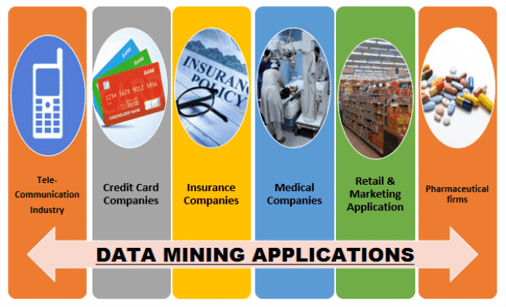
Data mining, wrangling,data manipulation techniques
Data Mining Applications
Retail
Financial services
Insurance
Manufacturing
Entertainment
Healthcare
Image Source: http://higssoftware.com/blog/data-mining-process-steps.php/
Notes:
Left (White Color space):
Title - Parent Topic
Subtitle - Subtopics of subtopics
Body Text - Description in bullets
Right (Grey Color Space):
Body Text - Relevant image (with source)/code snippet
Retail
Online retailers mine customer data and internet clickstream records to help them target marketing campaigns, ads and promotional offers to individual shoppers. Data mining and predictive modeling also power the recommendation engines that suggest possible purchases to website visitors, as well as inventory and supply chain management activities.
Financial services
Banks and credit card companies use data mining tools to build financial risk models, detect fraudulent transactions and vet loan and credit applications. Data mining also plays a key role in marketing and in identifying potential upselling opportunities with existing customers.
Insurance
Insurers rely on data mining to aid in pricing insurance policies and deciding whether to approve policy applications, including risk modeling and management for prospective customers.
Manufacturing
Data mining applications for manufacturers include efforts to improve uptime and operational efficiency in production plants, supply chain performance and product safety.
Entertainment
Streaming services do data mining to analyze what users are watching or listening to and to make personalized recommendations based on people's viewing and listening habits.
Healthcare
Data mining helps doctors diagnose medical conditions, treat patients and analyze X-rays and other medical imaging results. Medical research also depends heavily on data mining, machine learning and other forms of analytics.
Reference:
http://higssoftware.com/blog/data-mining-process-steps.php/

Slide 9
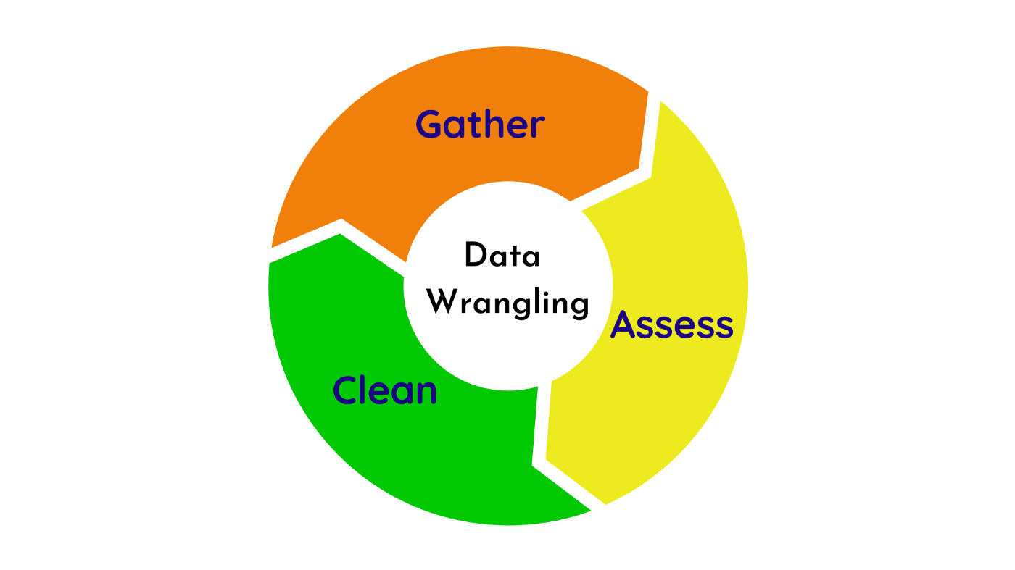
Data mining, wrangling,data manipulation techniques
Data Wrangling
Data wrangling is the process of cleaning and unifying messy and complex data sets for easy access and analysis.
Data Wrangling is also known as Data Munging.
Image Source: https://towardsdatascience.com/data-wrangling-raw-to-clean-transformation-b30a27bf4b3b
Notes:
Left (White Color space):
Title - Parent Topic
Subtitle - Subtopic 2
Body Text - Description in bullets
Right (Grey Color Space):
Body Text - Relevant image (with source)/code snippet
Data Wrangling is the process of gathering, collecting, and transforming Raw data into another format for better understanding, decision-making, accessing, and analysis in less time. Data Wrangling is also known as Data Munging.
Reference:
https://towardsdatascience.com/data-wrangling-raw-to-clean-transformation-b30a27bf4b3b

Slide 10
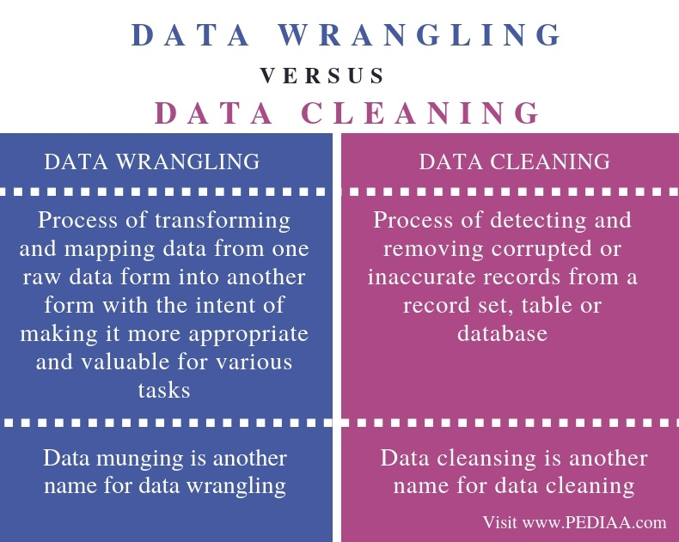
Data mining, wrangling,data manipulation techniques
What is the Purpose of Data Wrangling?
The primary purpose of data wrangling can be described as getting data in coherent shape
Image Source: https://pediaa.com/what-is-the-difference-between-data-wrangling-and-data-cleaning/
Notes:
This slide talks about the case if we have to divide a subtopic further.
Left (White Color space):
Title - Parent Topic
Subtitle - Subtopics of subtopics
Body Text - Description in bullets
Right (Grey Color Space):
Body Text - Relevant image (with source)/code snippet
Data wrangling involves processing the data in various formats and analyzes and get them to be used with another set of data and bringing them together into valuable insights. It further includes data aggregation, data visualization, and training statistical models for prediction
Reference:
https://pediaa.com/what-is-the-difference-between-data-wrangling-and-data-cleaning/

Slide 11
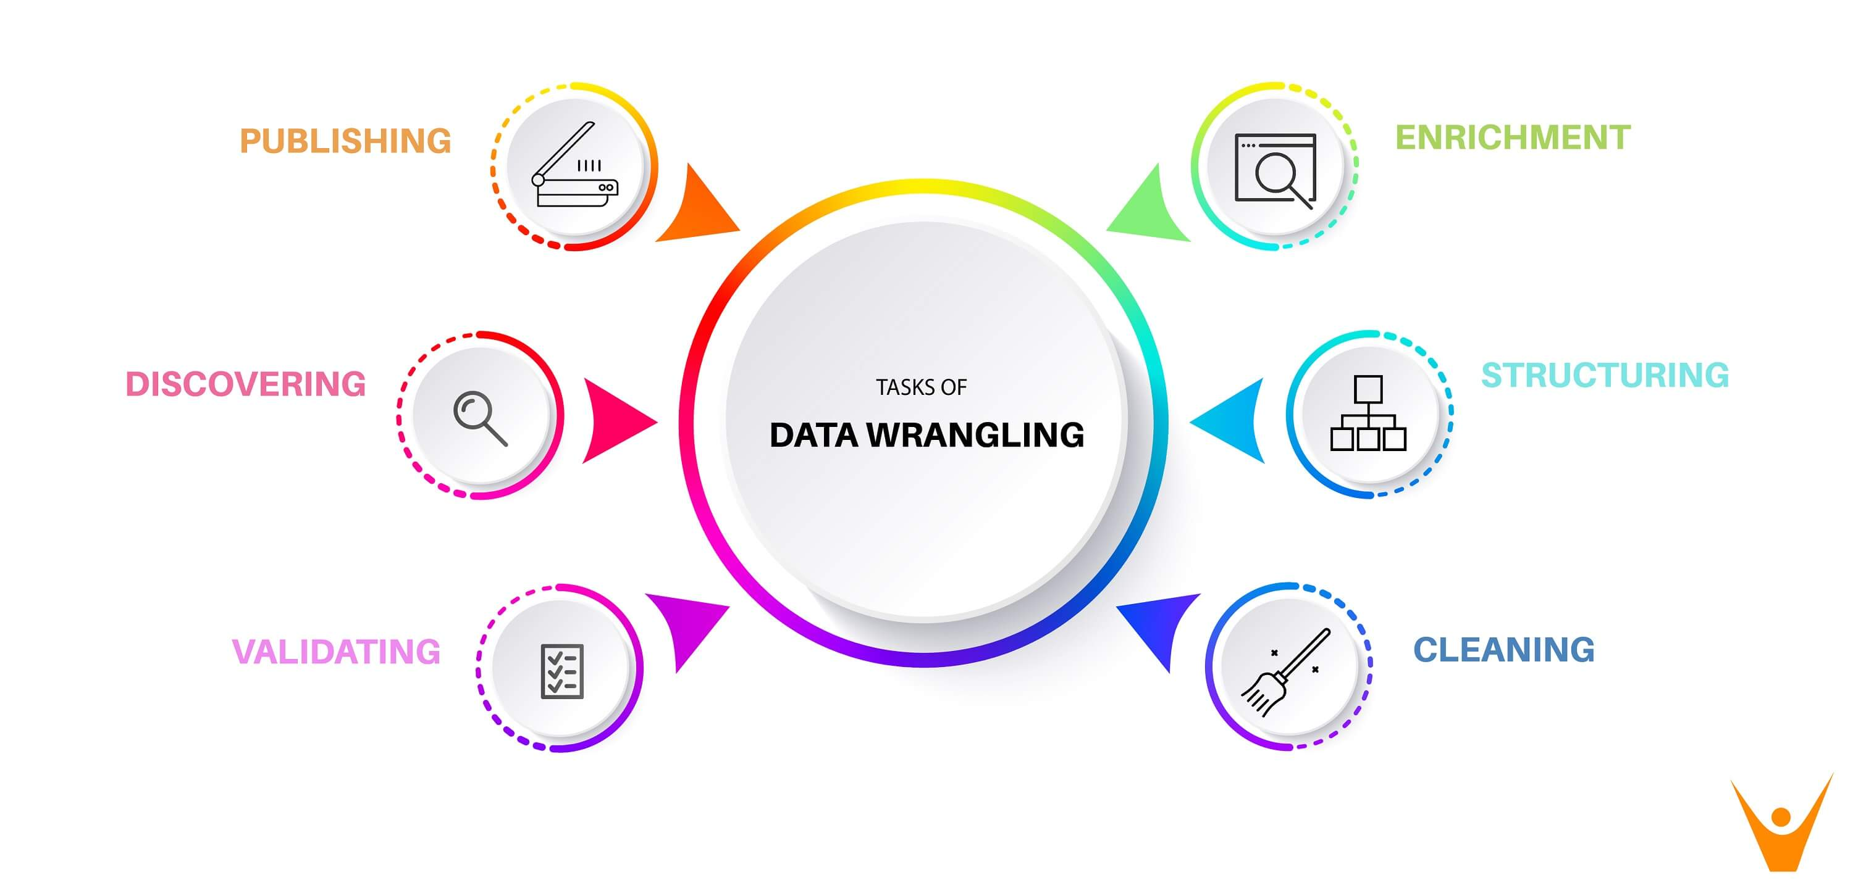
Data mining, wrangling,data manipulation techniques
Data Wrangling Steps
Data Discovery
Data Structuring
Data Cleaning
Data Enriching
Data Validating
Data Publishing
Image Source: https://favtutor.com/blogs/data-wrangling
Notes:
Left (White Color space):
Title - Parent Topic
Subtitle - Subtopics of subtopics
Body Text - Description in bullets
Right (Grey Color Space):
Body Text - Relevant image (with source)/code snippet
Data Discovery:
This is an all-encompassing term that describes understanding what your data is all about. In this first step, you get familiar with your data
Data Structuring:
When you collect raw data, it initially is in all shapes and sizes, and has no definite structure. Such data needs to be restructured to suit the analytical model that your enterprise plans to deploy
Data Cleaning:
Raw data comes with some errors that need to be fixed before data is passed on to the next stage. Cleaning involves the tackling of outliers, making corrections, or deleting bad data completely
Data Enriching:
By this stage, you have kind of become familiar with the data in hand. Now is the time to ask yourself this question – do you need to embellish the raw data? Do you want to augment it with other data?
Data Validating:
This activity surfaces data quality issues, and they have to be addressed with the necessary transformations. The rules of validation rules require repetitive programming steps to check the authenticity and the quality of your data
Data Publishing:
Once all the above steps are completed, the final output of your data wrangling efforts are pushed downstream for your analytics needs
Reference:
https://favtutor.com/blogs/data-wrangling

Slide 12
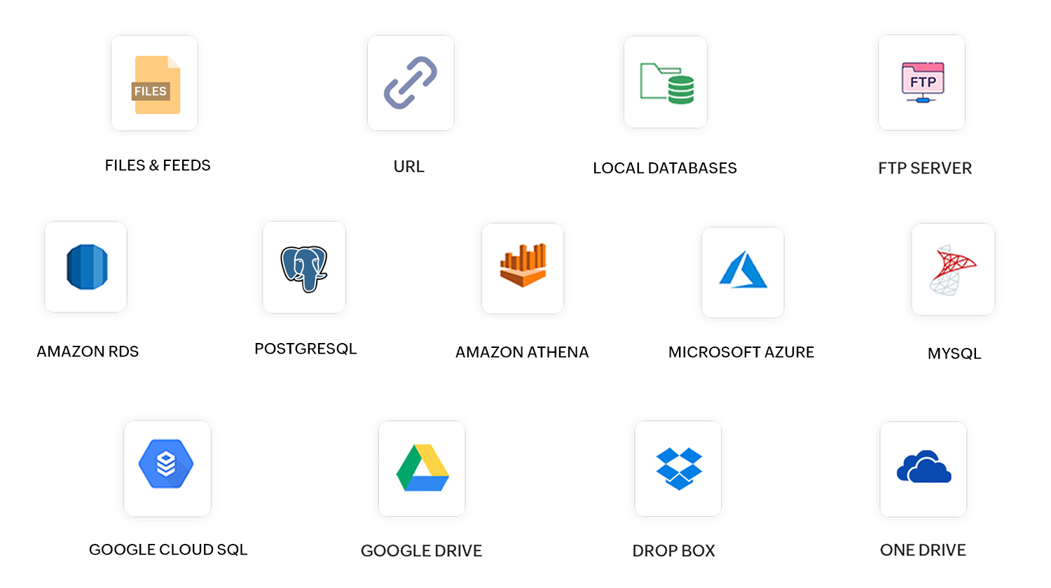
Data mining, wrangling,data manipulation techniques
Data Wrangling Tools
Excel Power Query / Spreadsheets
OpenRefine
Google DataPrep
Tabula
DataWrangler
CSVKit
Image Source: https://www.zohowebstatic.com/sites/default/files/dataprep/import-sources.png
/
Notes:
Left (White Color space):
Title - Parent Topic
Subtitle - Subtopics of subtopics
Body Text - Description in bullets
Right (Grey Color Space):
Body Text - Relevant image (with source)/code snippet
Excel Power Query / Spreadsheets: it is the basic manual structure wrangling tool.
OpenRefine: more sophisticated solutions, requires programming.
Google DataPrep: for data exploration, cleaning, and feature engineering.
Tabula: it's suitable for all kinds of data.
DataWrangler: used for data cleaning and transformation.
CSVKit: used for converting data.
Reference:
https://www.zohowebstatic.com/sites/default/files/dataprep/import-sources.png

Slide 13
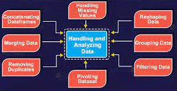
Data mining, wrangling,data manipulation techniques
Data Wrangling in Python
Numpy
Pandas
Matplotlib
Plotly
Theano
Image Source: https://pythongeeks.org/data-wrangling-in-python-with-examples/
/
Notes:
Left (White Color space):
Title - Parent Topic
Subtitle - Subtopics of subtopics
Body Text - Description in bullets
Right (Grey Color Space):
Body Text - Relevant image (with source)/code snippet
Numpy (aka Numerical Python)
the most basic package. Lots of features for operations on n-arrays and matrices in Python. The library provides vectorization of mathematical operations on the NumPy array type, which improves performance and accordingly speeds up the execution.
Pandas
designed for fast and easy data analysis operations. Useful for data structures with labeled axes. Explicit data alignment prevents common errors that result from misaligned data coming in from different sources.
Matplotlib
Python visualization module. Good for line graphs, pie charts, histograms, and other professional grade figures.
Plotly
for interactive, publication-quality graphs. Excellent for line plots, scatter plots, area charts, bar charts, error bars, box plots, histograms, heatmaps, subplots, multiple-axis, polar graphs, and bubble charts.
Theano
library for numerical computation similar to Numpy. This library is designed to define, optimize, and evaluate mathematical expressions involving multi-dimensional arrays efficiently.
Reference:
https://pythongeeks.org/data-wrangling-in-python-with-examples/

Slide 14

Data mining, wrangling,data manipulation techniques
Data Manipulation
Pandas is an open-source python library that is used for data manipulation and analysis.
It provides many functions and methods to speed up the data analysis process.
Image Source: https://www.astera.com/type/blog/data-manipulation-tools/
Notes:
Left (White Color space):
Title - Parent Topic
Subtitle - Subtopic 3
Body Text - Description in bullets
Right (Grey Color Space):
Body Text - Relevant image (with source)/code snippet
Pandas is a newer package built on top of NumPy, and provides an efficient implementation of a DataFrame . DataFrame s are essentially multidimensional arrays with attached row and column labels, and often with heterogeneous types and/or missing data.
Reference:
https://www.astera.com/type/blog/data-manipulation-tools

Slide 15

Data mining, wrangling,data manipulation techniques
What are Data Manipulations?
Data manipulation with python is defined as a process in the python programming language that enables users in data organization in order to make reading or interpreting the insights from the data more structured and comprises of having better design.
Image Source: https://etipsguruji.com/data-manipulation-benefits-advantage/
/
Notes:
This slide talks about the case if we have to divide a subtopic further.
Left (White Color space):
Title - Parent Topic
Subtitle - Subtopics of subtopics
Body Text - Description in bullets
Right (Grey Color Space):
Body Text - Relevant image (with source)/code snippet
For example, arranging the employee’s names in alphabetical order will enable quicker searching of a particular employee by their name. The key feature of data manipulation is enabling faster business operations and also emphasize optimization in the process. Through proper manipulated data one can analyze trends, interpret insights from financial data, analyze consumer behaviour or pattern, etc. Not only the analyzing, but it also enables users to neglect any unnecessary data in the set so that one can save space and only fill the limited space with important and necessary data.
Reference:
https://etipsguruji.com/data-manipulation-benefits-advantage/

Slide 16
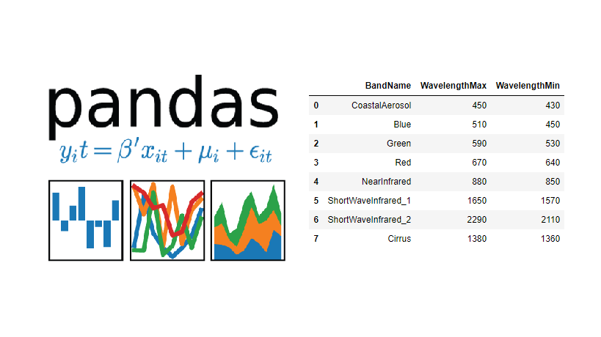
Data mining, wrangling,data manipulation techniques
Pandas
Pandas is an open source Python package that is most widely used for data science/data analysis and machine learning tasks.
It is built on top of another package named Numpy, which provides support for multi-dimensional arrays.
Image Source: https://towardsdatascience.com/manipulating-the-data-with-pandas-using-python-be6c5dfabd47
Notes:
Left (White Color space):
Title - Parent Topic
Subtitle - Subtopics of subtopics
Body Text - Description in bullets
Right (Grey Color Space):
Body Text - Relevant image (with source)/code snippet
module is basically an open-source Python module. It has a wide scope of use in the field of computing, data analysis, statistics, etc.
Pandas’ module uses the basic functionalities of the NumPy module.
Reference:
https://towardsdatascience.com/manipulating-the-data-with-pandas-using-python-be6c5dfabd47

Slide 17
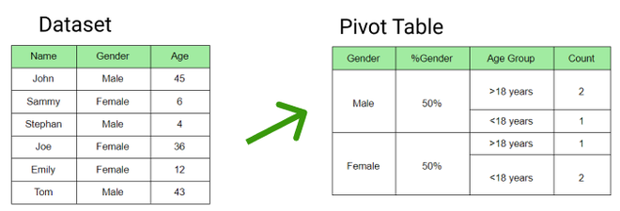
Data mining, wrangling,data manipulation techniques
9 Effective Pandas Techniques in Python for Data Manipulation
Pivot Table
Boolean Indexing
Apply Function
Crosstab
Merge DataFrames
Sorting DataFrames
Plotting
Cut function
Impute Missing Values
Image Source: https://media.geeksforgeeks.org/wp-content/uploads/20210109131825/Annotation20210109131527-660x225.png
Notes:
Left (White Color space):
Title - Parent Topic
Subtitle - Subtopics of subtopics
Body Text - Description in bullets
Right (Grey Color Space):
Body Text - Relevant image (with source)/code snippet
Pivot Table
Pandas can be practised to produce MS Excel style pivot tables. For example, in a table, a key column which has missing values.
Boolean Indexing
Boolean Indexing is used if user wants to filter the values of a column based on conditions from another set of columns
Apply Function
It is one of the regularly used functions for working with data and building new variables
Crosstab
This function is used to get an original view of the data. The function provides scope to validate some fundamental hypothesis
Merge DataFrames
Merging data frames is vital when a user has data coming from various sources to be related.
Sorting DataFrames
When a user wants to sort pandas data frame based on the values of one or more columns or sort based on the contents of row index or row names of the panda’s data frame. Pandas data frame has two useful functions
sort_values(): this command is used to sort pandas data frame by one or more columns
sort_index(): this command is used to sort pandas data frame by row index
Plotting
Analyzing data from different columns can be very illuminating. Pandas make doing so simple with multi-column DataFrames. By default, calling df.plot() will make pandas to over-plot all column data, with each column as a single line.
Cut function
Seldom numerical values make more sense if grouped together.
Impute Missing Values
Imputing relates to applying a model to restore missing values.
There are several options users can consider while replacing a missing value, for example:
A fixed value that has meaning within the domain, such as 0, distinct from all other values.A value from another randomly chosen from the record.
A mean, median or mode value replaced for the column.
A value determined by another predictive model.
Reference:
https://media.geeksforgeeks.org/wp-content/uploads/20210109131825/Annotation20210109131527-660x225.png

Slide 18
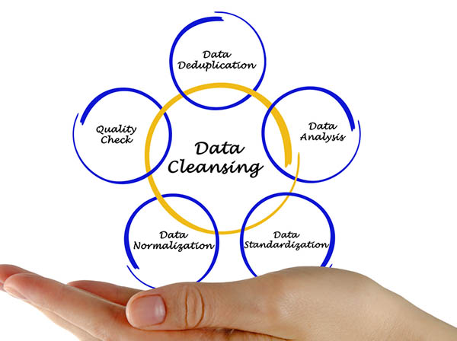
Data cleaning and pre-processing techniques
Data Cleaning
Data cleaning is the process of fixing or removing incorrect, corrupted, incorrectly formatted, duplicate, or incomplete data within a dataset.
Image Source: https://www.dataversity.net/what-is-data-cleansing/
Notes:
Left (White Color space):
Title - Parent Topic
Subtitle – Subtopic 1
Body Text - Description in bullets
Right (Grey Color Space):
Body Text - Relevant image (with source)/code snippet
Data cleaning or cleansing is the process of detecting and correcting (or removing) corrupt or inaccurate records from a record set, table, or database and refers to identifying incomplete, incorrect, inaccurate or irrelevant parts of the data and then replacing, modifying, or deleting the dirty or coarse data.
Reference:
https://www.dataversity.net/what-is-data-cleansing/

Slide 19
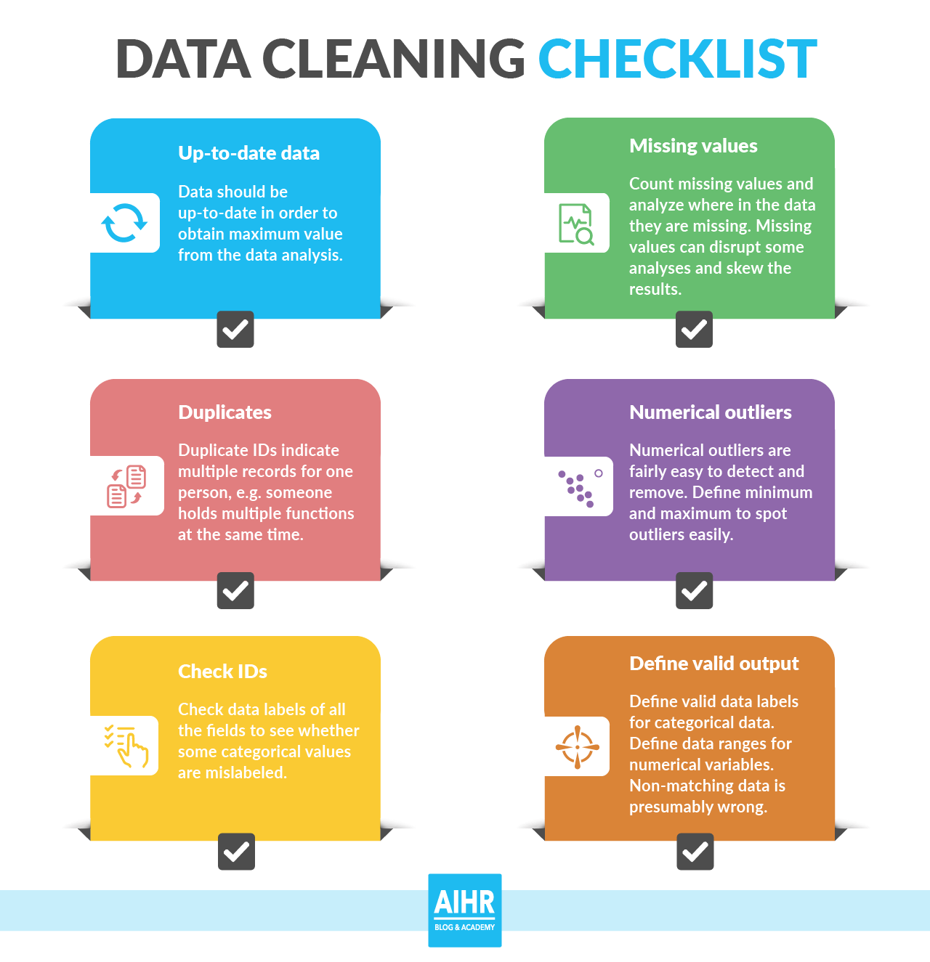
Data cleaning and pre-processing techniques
Why data cleaning is essential?
Error-Free Data
Data Quality
Accurate and Efficient
Complete Data
Maintains Data Consistency
Image Source: https://medium.com/@nicklauswinters/data-cleaning-22b790eea834
Notes:
This slide talks about the case if we have to divide a subtopic further.
Left (White Color space):
Title - Parent Topic
Subtitle - Subtopics of subtopics
Body Text - Description in bullets
Right (Grey Color Space):
Body Text - Relevant image (with source)/code snippet
Missing data is always a problem in real life scenarios. Areas like machine learning and data mining face severe issues in the accuracy of their model predictions because of poor quality of data caused by missing values.
Reference:
https://medium.com/@nicklauswinters/data-cleaning-22b790eea834

Slide 20
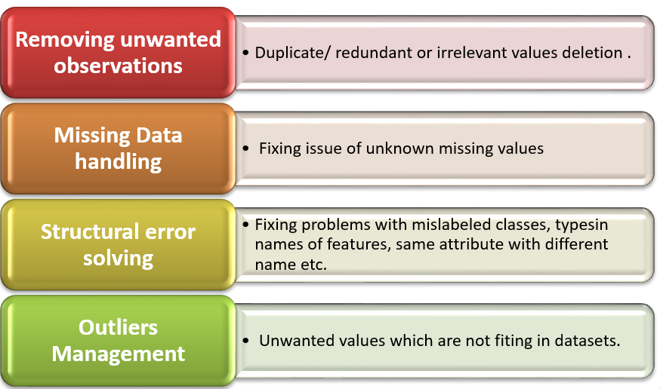
Data cleaning and pre-processing techniques
8 effective data cleaning techniques
Remove duplicates
Remove irrelevant data
Standardize capitalization
Convert data type
Clear formatting
Fix errors
Language translation
Handle missing values
Image Source: https://prwatech.in/blog/machine-learning/data-cleaning-in-machine-learning/
Notes:
Left (White Color space):
Title - Parent Topic
Subtitle - Subtopics of subtopics
Body Text - Description in bullets
Right (Grey Color Space):
Body Text - Relevant image (with source)/code snippet
1. Remove Duplicates
When you collect your data from a range of different places, or scrape your data, it’s likely that you will have duplicated entries. These duplicates could originate from human error where the person inputting the data or filling out a form made a mistake.
Duplicates will inevitably skew your data and/or confuse your results. They can also just make the data hard to read when you want to visualize it, so it’s best to remove them right away.
2. Remove Irrelevant Data
Irrelevant data will slow down and confuse any analysis that you want to do. So, deciphering what is relevant and what is not is necessary before you begin your data cleaning. For instance, if you are analyzing the age range of your customers, you don’t need to include their email addresses.
Other elements you’ll need to remove as they add nothing to your data include:
Personal identifiable (PII) data
URLs
HTML tags
Boilerplate text (for ex. in emails)
Tracking codes
Excessive blank space between text
3. Standardize Capitalization
Within your data, you need to make sure that the text is consistent. If you have a mixture of capitalization, this could lead to different erroneous categories being created.
It could also cause problems when you need to translate before processing as capitalization can change the meaning. For instance, Bill is a person's name whereas a bill or to bill is something else entirely.
If, in addition to data cleaning, you are text cleaning in order to process your data with a computer model, it’s much simpler to put everything in lowercase.
4. Convert Data Types
Numbers are the most common data type that you will need to convert when cleaning your data. Often numbers are imputed as text, however, in order to be processed, they need to appear as numerals.
If they are appearing as text, they are classed as a string and your analysis algorithms cannot perform mathematical equations on them.
The same is true for dates that are stored as text. These should all be changed to numerals. For example, if you have an entry that reads September 24th 2021, you’ll need to change that to read 09/24/2021.
5. Clear Formatting
Machine learning models can’t process your information if it is heavily formatted. If you are taking data from a range of sources, it’s likely that there are a number of different document formats. This can make your data confusing and incorrect.
You should remove any kind of formatting that has been applied to your documents, so you can start from zero. This is normally not a difficult process, both excel and google sheets, for example, have a simple standardization function to do this.
6. Fix Errors
It probably goes without saying that you’ll need to carefully remove any errors from your data. Errors as avoidable as typos could lead to you missing out on key findings from your data. Some of these can be avoided with something as simple as a quick spell-check.
Spelling mistakes or extra punctuation in data like an email address could mean you miss out on communicating with your customers. It could also lead to you sending unwanted emails to people who didn’t sign up for them.
Other errors can include inconsistencies in formatting. For example, if you have a column of US dollar amounts, you’ll have to convert any other currency type into US dollars so as to preserve a consistent standard currency. The same is true of any other form of measurement such as grams, ounces, etc.
7. Language Translation
To have consistent data, you’ll want everything in the same language.
The Natural Language Processing (NLP) models behind software used to analyze data are also predominantly monolingual, meaning they are not capable of processing multiple languages. So, you’ll need to translate everything into one language.
8. Handle Missing Values
When it comes to missing values you have two options:
Remove the observations that have this missing value
Input the missing data
What you choose to do will depend on your analysis goals and what you want to do next with your data.
Reference:
https://prwatech.in/blog/machine-learning/data-cleaning-in-machine-learning/

Slide 21

Data cleaning and pre-processing techniques
6 Steps to Manipulate and Cleanse Data with Python
Imputing Missing Values
Outlier and Anomaly Detection
X-Variable Cleaning Methods
Y-Variable Cleaning Methods
Merging DataFrames
Parsing Dates
Image Source: https://brightdata.com/blog/how-tos/data-manipulation-cleaning-python
Notes:
Left (White Color space):
Title - Parent Topic
Subtitle - Subtopics of subtopics
Body Text - Description in bullets
Right (Grey Color Space):
Body Text - Relevant image (with source)/code snippet
1.Implementing missing values imputation – This is a standard statistical imputing constant, using KNN imputation.
Outlier/Anomaly Detection is carried out using: Isolation Forest, One Class SVM, Local Outlier Factor, and/or outlier detection algorithms.
2. Carrying out outlier/anomaly detection- You can accomplish this by using Isolation Forest, One-Class SVM, and/or Local Outlier Factor outlier detection algorithms.
3.Utilizing cleaning techniques from the X-Variable family- In this instance, you want to apply custom functions, remove duplicates, as well as replace crucial values.
4.Using Cleaning Techniques of the Y-Variable sort – Here it is important to do label encoding, one-hot encoding, as well as dictionary mapping.
5.DataFrames’ need to be merged- This step includes concatenating, merging, and joining.
6.The last step consists of ‘parsing dates’- Here you need to use auto-format detecting strings to accomplish ‘DateTime’ converting, including changing ‘DateTime’ objects to numbers.
Reference:
https://brightdata.com/blog/how-tos/data-manipulation-cleaning-python

Slide 22
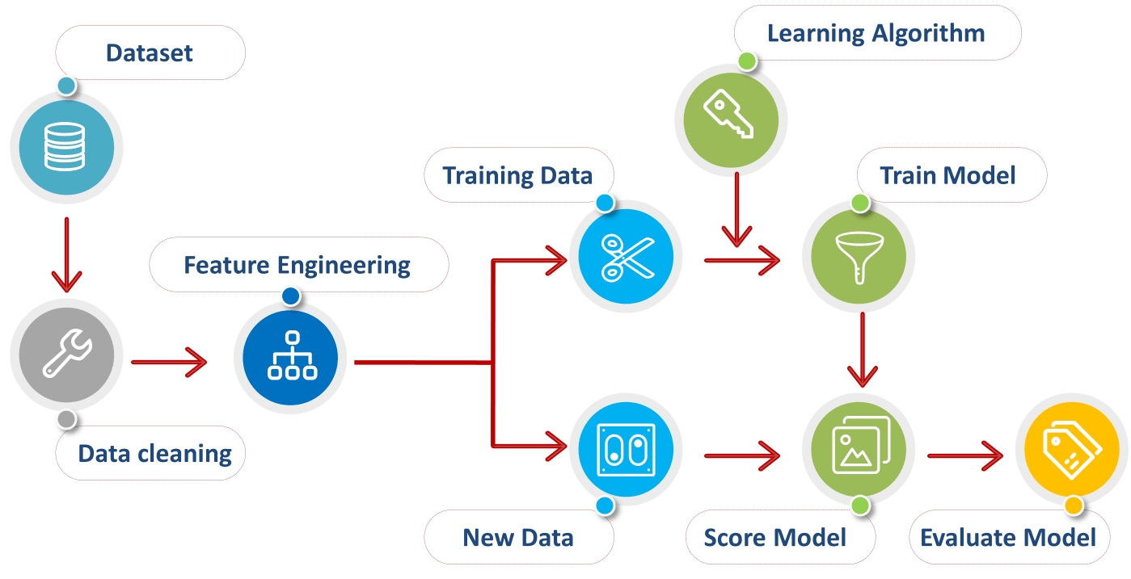
Data cleaning and pre-processing techniques
Data Pre-processing
Data pre-processing is a data mining technique which is used to transform the raw data in a useful and efficient format.
Image Source: https://medium.datadriveninvestor.com/data-preprocessing-3cd01eefd438
Notes:
Left (White Color space):
Title - Parent Topic
Subtitle - Subtopic 2
Body Text - Description in bullets
Right (Grey Color Space):
Body Text - Relevant image (with source)/code snippet
Data pre-processing is a step in the data mining and data analysis process that takes raw data and transforms it into a format that can be understood and analyze by computers and machine learning.
Reference:
https://medium.datadriveninvestor.com/data-preprocessing-3cd01eefd438

Slide 23
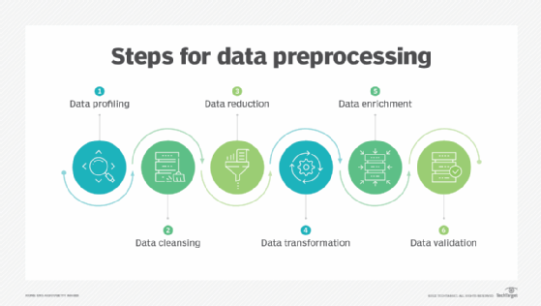
Data cleaning and pre-processing techniques
Data Pre-processing Steps
Data quality assessment
Data cleaning
Data transformation
Data reduction
Image Source: https://www.techtarget.com/searchdatamanagement/definition/data-preprocessing
Notes:
This slide talks about the case if we have to divide a subtopic further.
Left (White Color space):
Title - Parent Topic
Subtitle - Subtopics of subtopics
Body Text - Description in bullets
Right (Grey Color Space):
Body Text - Relevant image (with source)/code snippet
Data quality assessment
Take a good look at your data and get an idea of its overall quality, relevance to your project, and consistency.
Data cleaning
Data cleaning is the process of adding missing data and correcting, repairing, or removing incorrect or irrelevant data from a data set.
Data transformation
With data cleaning, we’ve already begun to modify our data, but data transformation will begin the process of turning the data into the proper format(s) you’ll need for analysis and other downstream processes.
Reference:
https://www.techtarget.com/searchdatamanagement/definition/data-preprocessing

Slide 24
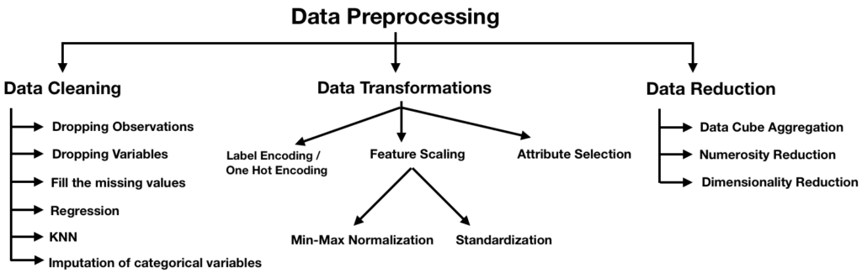
Data cleaning and pre-processing techniques
Steps involved in data pre-processing
Importing the required Libraries
Importing the data set
Handling the Missing Data.
Encoding Categorical Data.
Splitting the data set into test set and training set.
Feature Scaling.
Image Source: https://brain-mentors.com/wp-content/uploads/2020/05/Untitled-picture-9-1024x325.png
Notes:
Left (White Color space):
Title - Parent Topic
Subtitle - Subtopics of subtopics
Body Text - Description in bullets
Right (Grey Color Space):
Body Text - Relevant image (with source)/code snippet
Steps involved in data pre-processing :
Importing the required Libraries
Importing the data set
Handling the Missing Data.
Encoding Categorical Data.
Splitting the data set into test set and training set.
Feature Scaling.
Reference:
https://brain-mentors.com/wp-content/uploads/2020/05/Untitled-picture-9-1024x325.png

Slide 25
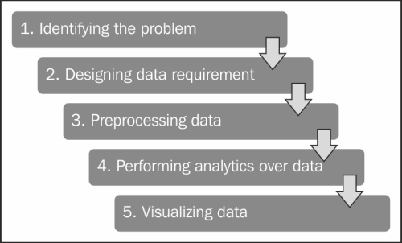
Data analytics project lifecycle
Project lifecycle
Domain/Business Understanding
Data collection/Data Exploration
Data Cleaning
Feature Engineering
Modelling
Image Source: https://pingax.com/understanding-data-analytics-project-life-cycle/
Notes:
Left (White Color space):
Title - Parent Topic
Subtitle - Subtopic 1
Body Text - Description in bullets
Right (Grey Color Space):
Body Text - Relevant image (with source)/code snippet
Domain/Business Understanding:
This initial phase focuses on understanding the project objectives and requirements from a business perspective, and then converting this knowledge into a data mining.
Understand the Business Process, beliefs, data generation process and storage.
Its very important to spend a good amount of time in this step so that the future once become more relevant to perform and there are less chances of errors.
Data collection/Data Exploration:
The data understanding phase starts with an initial data collection and proceeds with activities in order to get familiar with the data, to identify data quality problems, to discover first insights into the data, or to detect interesting subsets to form hypotheses for hidden information.
Data Cleaning:
It basically includes filling the missing values, dropping irrelevant and duplicate data. Handling outliers and unnatural values.
Feature Engineering:
Feature engineering is about creating new input features from your existing ones.
In general, you can think of data cleaning as a process of subtraction and feature engineering as a process of addition.
Getting Qualitative and quantitative information from the data, Feature selection using Data Visualization.
Modelling:
In this phase, various modelling techniques are selected and applied and their parameters are calibrated to optimal values. Typically, there are several techniques for the same data mining problem type. Some techniques have specific requirements on the form of data. Therefore, it is often required to step back to the data preparation phase.
Reference:
: https://pingax.com/understanding-data-analytics-project-life-cycle/

Slide 26
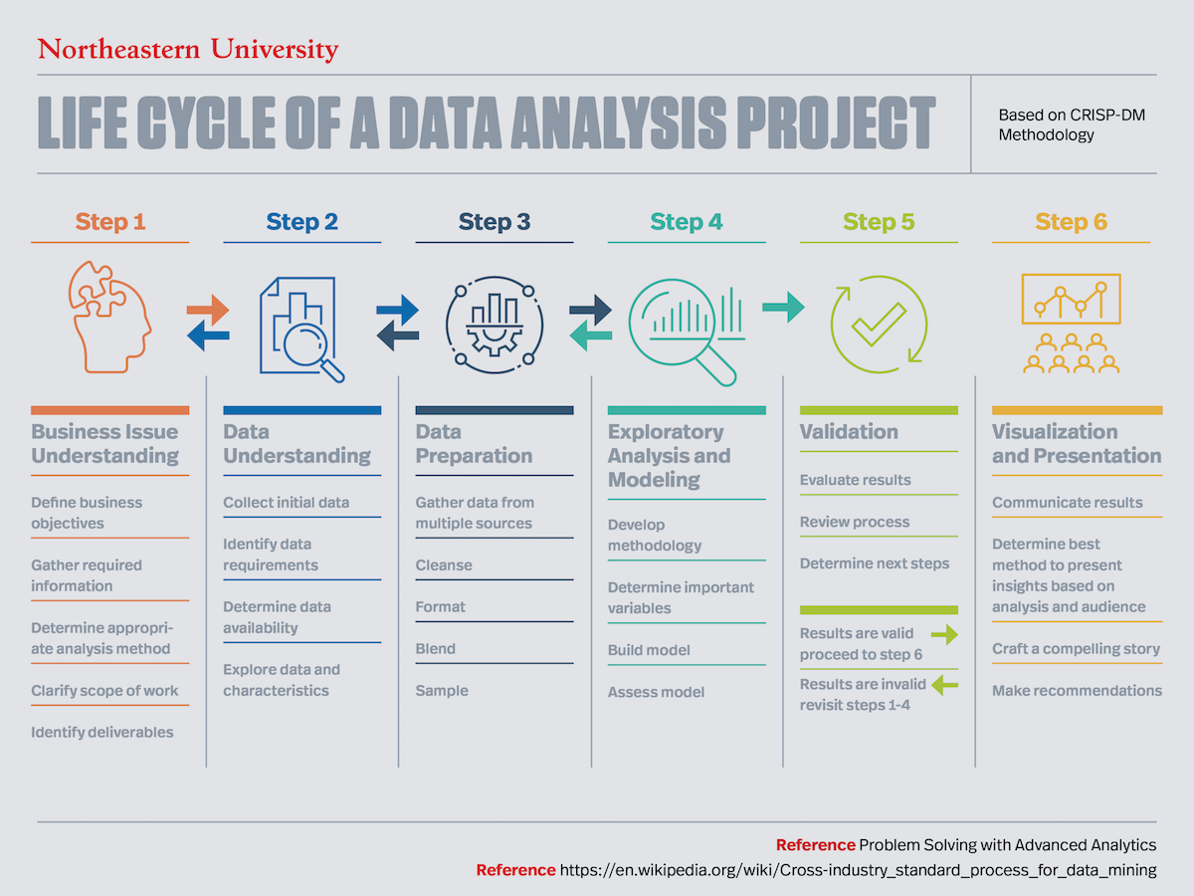
Data analytics project lifecycle
Project lifecycle
Evaluation
Optimization and Tuning
Deploy the Model to production
Monitor the performance during Production
Image Source: https://www.northeastern.edu/graduate/blog/data-analysis-project-lifecycle/
/
Notes:
Left (White Color space):
Title - Parent Topic
Subtitle - Subtopic 1
Body Text - Description in bullets
Right (Grey Color Space):
Body Text - Relevant image (with source)/code snippet
Evaluation:
At this stage in the project, you have built a model (or models) that appears to have high quality, from a data analysis perspective. Before proceeding to final deployment of the model, it is important to evaluate the model thoroughly and review the steps executed to construct the model, to be certain it properly achieves the business objectives.
Optimization and Tuning:
Even after evaluation of Model there can be certain requirements which can be raised at time of evaluation, Analyzing the same and integrating in the model.
Deploy the Model to production:
Finally, after all the UAT and implementing changes during UAT, the model is finally put to production. i.e the same goes live.
Monitor the performance during Production:
It takes some time to settle the model in live environment and familiarize the audience with the new features, so a continuous monitor is required so that any discrepancies can be solved straight away
Reference:
https://www.northeastern.edu/graduate/blog/data-analysis-project-lifecycle/

Slide 27
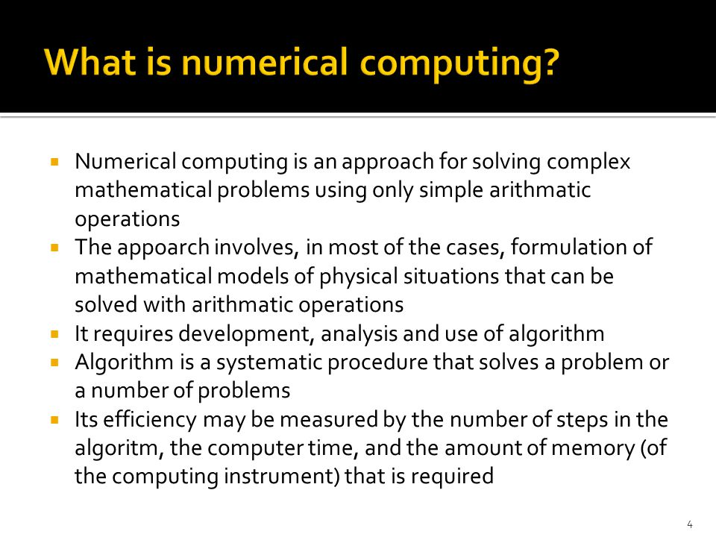
Numerical Computing using NumPy Library
What is Numerical Computing?
Numerical computing is an approach for solving complex mathematical problems using only simple arithmetic operations.
Numerical Python has a fixed-size, homogeneous (fixed-type), multi-dimensional array type and lots of functions for various array operations.
Image Source: https://slideplayer.com/slide/4519120/15/images/4/What+is+numerical+computing.jpg
Notes:
Left (White Color space):
Title - Parent Topic
Subtitle - Subtopic 1
Body Text - Description in bullets
Right (Grey Color Space):
Body Text - Relevant image (with source)/code snippet
Numerical computing is an approach for solving complex mathematical problems using only simple arithmetic operations
The approach involves formulation of mathematical models physical situations that can be solved with arithmetic operations
It requires development, analysis and use of algorithms.
Reference:
https://slideplayer.com/slide/4519120/15/images/4/What+is+numerical+computing.jpg

Slide 28
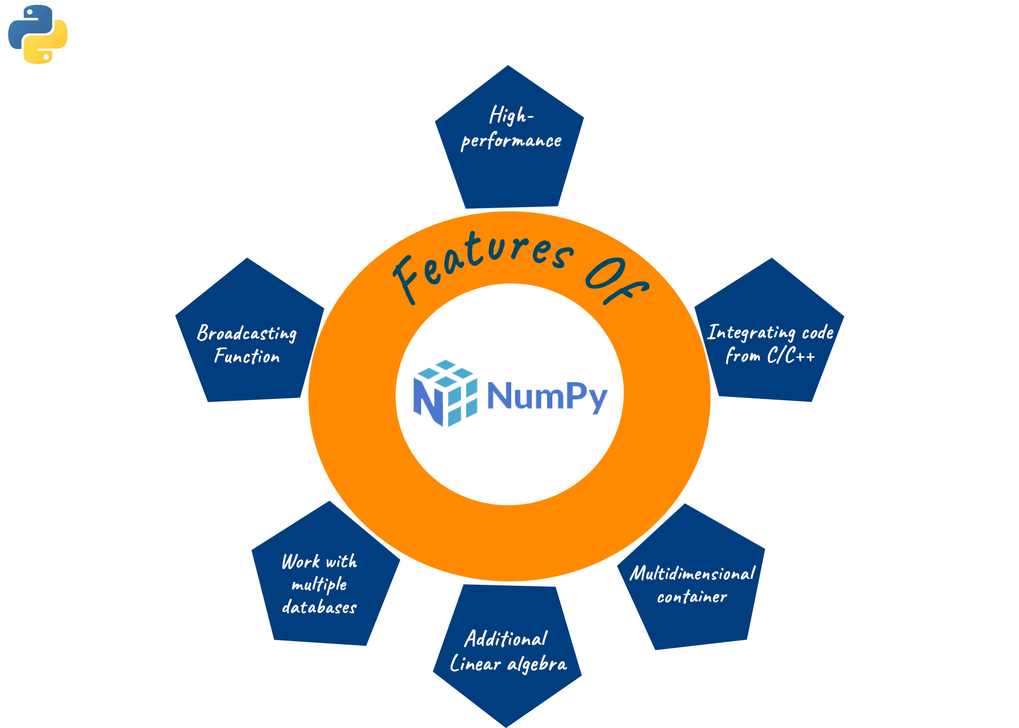
Numerical Computing using NumPy Library
What is NumPy in Python?
NumPy is an open-source library available in Python, which helps in mathematical, scientific, engineering, and data science programming.
It is a very useful library to perform mathematical and statistical operations in Python.
Image Source: https://favtutor.com/blogs/numpy-vs-pandas
Notes:
This slide talks about the case if we have to divide a subtopic further.
Left (White Color space):
Title - Parent Topic
Subtitle - Subtopics of subtopics
Body Text - Description in bullets
Right (Grey Color Space):
Body Text - Relevant image (with source)/code snippet
NumPy, which stands for Numerical Python, is a library consisting of multidimensional array objects and a collection of routines for processing those arrays.
NumPy is a Python package. It stands for 'Numerical Python'.
Reference:
https://favtutor.com/blogs/numpy-vs-pandas

Slide 29
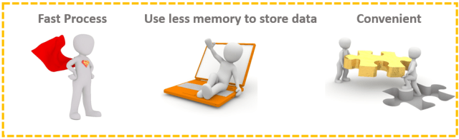
Numerical Computing using NumPy Library
Why use NumPy?
NumPy is memory efficiency, meaning it can handle the vast amount of data more accessible than any other library.
Image Source: https://indianaiproduction.com/python-numpy-tutorial/
Notes:
Left (White Color space):
Title - Parent Topic
Subtitle - Subtopics of subtopics
Body Text - Description in bullets
Right (Grey Color Space):
Body Text - Relevant image (with source)/code snippet
Faster
Uses less memory to store data.
Convenient.
Reference:
https://indianaiproduction.com/python-numpy-tutorial/

Slide 30
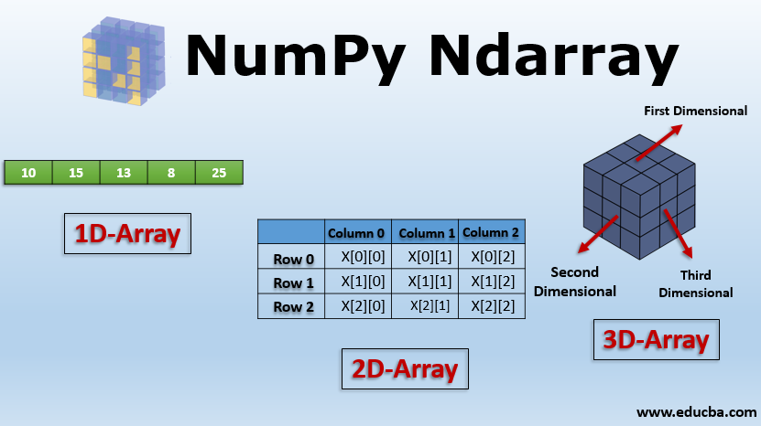
Numerical Computing using NumPy Library
Creating Arrays
The array object in NumPy is called ndarray.
We can create a NumPy ndarray object by using the array() function.
Image Source: https://medium.com/analytics-vidhya/introduction-to-numpy-16a6efaffdd7
Notes:
Left (White Color space):
Title - Parent Topic
Subtitle - Subtopics of subtopics
Body Text - Description in bullets
Right (Grey Color Space):
Body Text - Relevant image (with source)/code snippet
Dimensions in Arrays
A dimension in arrays is one level of array depth (nested arrays).
0-D Arrays
0-D arrays, or Scalars, are the elements in an array. Each value in an array is a 0-D array.
1-D Arrays
An array that has 0-D arrays as its elements is called uni-dimensional or 1-D array.
2-D Arrays
An array that has 1-D arrays as its elements is called a 2-D array.
These are often used to represent matrix or 2nd order tensors.
3-D arrays
An array that has 2-D arrays (matrices) as its elements is called 3-D array.
These are often used to represent a 3rd order tensor.
Reference:
https://medium.com/analytics-vidhya/introduction-to-numpy-16a6efaffdd7

Slide 31
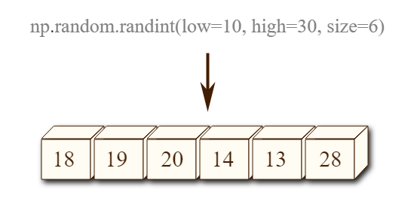
Numerical Computing using NumPy Library
Random Numbers using NumPy
NumPy offers the random module to work with random numbers.
rand()
randint()
choice()
Image Source: https://www.w3resource.com/python-exercises/numpy/python-numpy-random-exercise-2.php
Notes:
Left (White Color space):
Title - Parent Topic
Subtitle - Subtopics of subtopics
Body Text - Description in bullets
Right (Grey Color Space):
Body Text - Relevant image (with source)/code snippet
Generate Random Number
NumPy offers the random module to work with random numbers.
from numpy import random
x = random.randint(100)
print(x)
The random module's rand() method returns a random float between 0 and 1.
from numpy import random
x = random.rand()
print(x)
Generate Random Array
The randint() method takes a size parameter where you can specify the shape of an array.
Generate a 1-D array containing 5 random integers from 0 to 100:
from numpy import random
x=random.randint(100, size=(5))
print(x)
Generate a 2-D array with 3 rows, each row containing 5 random integers from 0 to 100:
from numpy import random
x = random.randint(100, size=(3, 5))
print(x)
The choice() method allows you to generate a random value based on an array of values.
from numpy import random
x = random.choice([3, 5, 7, 9])
print(x)
Reference:
: https://www.w3resource.com/python-exercises/numpy/python-numpy-random-exercise-2.php

Slide 32
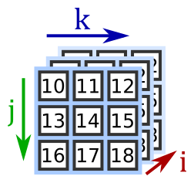
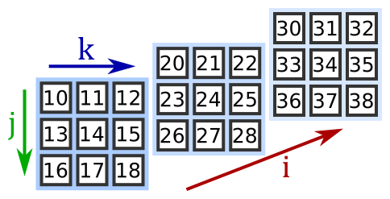
Numerical Computing using NumPy Library
Indexing and Slicing in Python
Array indexing is the same as accessing an array element.
Slicing in python means taking elements from one given index to another given index.
Image Source: https://www.pythoninformer.com/python-libraries/numpy/index-and-slice/
Notes:
Left (White Color space):
Title - Parent Topic
Subtitle - Subtopics of subtopics
Body Text - Description in bullets
Right (Grey Color Space):
Body Text - Relevant image (with source)/code snippet
Access Array Elements
Array indexing is the same as accessing an array element.
You can access an array element by referring to its index number.
The indexes in NumPy arrays start with 0, meaning that the first element has index 0, and the second has index 1 etc.
Get the first element from the following array:
import numpy as np
arr = np.array([1, 2, 3, 4])
print(arr[0])
Slicing arrays
Slicing in python means taking elements from one given index to another given index.
We pass slice instead of index like this: [start:end].
We can also define the step, like this: [start:end:step].
If we don't pass start its considered 0
If we don't pass end its considered length of array in that dimension
If we don't pass step its considered 1
Slice elements from index 1 to index 5 from the following array:
import numpy as np
arr = np.array([1, 2, 3, 4, 5, 6, 7])
print(arr[1:5])
Reference:
https://www.pythoninformer.com/python-libraries/numpy/index-and-slice/

Slide 33

Numerical Computing using NumPy Library
Statistical Functions in Python
median: This will return the median along the specified axis.
average: This will return the weighted average along the specified axis.
mean: This will return the arithmetic mean along the specified axis.
std: This will return the standard deviation along the specified axis.
var: This will return the variance along the specified axis.
Image Source: https://d3mxt5v3yxgcsr.cloudfront.net/courses/3391/course_3391_image.jpg
Notes:
Left (White Color space):
Title - Parent Topic
Subtitle - Subtopics of subtopics
Body Text - Description in bullets
Right (Grey Color Space):
Body Text - Relevant image (with source)/code snippet
In Numpy, we can perform various statistical calculations using the various functions that are provided in the library like Order statistics, Averages and variances, correlating, Histograms.
Let us work on some of those statistical functions.
Order statistics:
amin: This will return the minimum of an array.
amax: This will return the maximum of an array.
Averages and variances:
median: This will return the median along the specified axis.
average: This will return the weighted average along the specified axis.
mean: This will return the arithmetic mean along the specified axis.
std: This will return the standard deviation along the specified axis.
var: This will return the variance along the specified axis.
Histograms:
histogram: This will return the computed histogram of a set of data.
Reference:
https://d3mxt5v3yxgcsr.cloudfront.net/courses/3391/course_3391_image.jpg

Slide 34
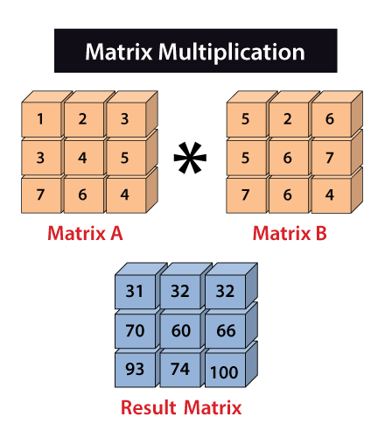
Numerical Computing using NumPy Library
Matrix Multiplication in Python
The Numpy matmul() function is used to return the matrix product of 2 arrays.
.
Image Source: https://www.javatpoint.com/numpy-matrix-multiplication
Notes:
Left (White Color space):
Title - Parent Topic
Subtitle - Subtopics of subtopics
Body Text - Description in bullets
Right (Grey Color Space):
Body Text - Relevant image (with source)/code snippet
The Numpy matmul() function is used to return the matrix product of 2 arrays.
2-D arrays, it returns normal product
Dimensions > 2, the product is treated as a stack of matrix
1-D array is first promoted to a matrix, and then the product is calculated
Reference:
https://www.javatpoint.com/numpy-matrix-multiplication

